Slide 1
Automobile Market Analysis Project Part 1

Slide 2
Dzire gives the best mileage which is manufactured by Suzuki
Tata Nano is best for small engine with good mileage
Maruti Suzuki has the most fuel-efficient cars

Slide 3
Suzuki is the top hatchback maker with the highest number of cars
Mileage goes down as engine size increases (negative correlation)
No strong link between fuel tank size and mileage

Slide 4
Top cars for adventurous drives are listed
Bmw x4 is the best for adventure drives followed by ford and Toyota
Good family cars are given in the list where they can choosen by our choice
Top place is occupied by BMW X7

Slide 5
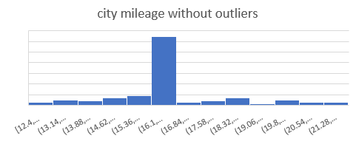
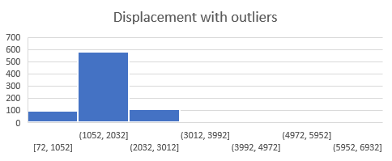
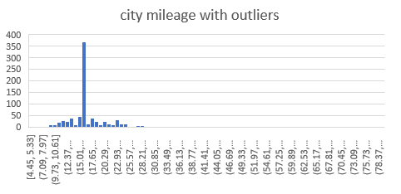
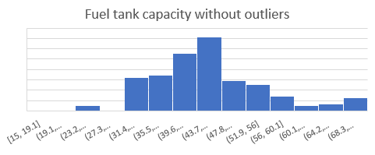
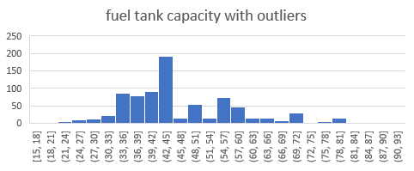
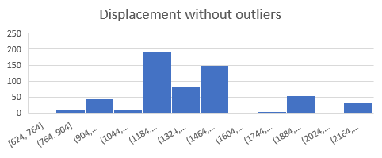
Comparison of graphs with outliers and without outliers

Slide 6
The top most manufacturers in hatchback segment is Suzuki
In sedan the first place captured by hyundai and in suv it is mahindra
The hyundai manufacturers is a heavy comptitor in all the 3 segments.

Slide 7
The most popular body type in the market is hatchback followed by suv and sedan
The sedan,coupe as these body type is new to the market it occupies the last position
There is a huge number difference between the top 3 and the other body types.

Slide 8
Automobile Market Analysis Project Part 2

Slide 9
Maruti Suzuki offers the most car variants, especially in the hatchback segment.
Hyundai is second in offering a wide variety, especially in hatchbacks and SUVs.
These two brands dominate the market with options that appeal to different customer needs.
Other segments like MUVs, Crossovers, and Sedans have fewer options.

Slide 10
The correlation coefficient is moderate negative correlation
The correlation coefficient is strong positive correlation
Cars with larger fuel tanks usually have lower city mileage.
Cars with higher engine size(displacement) tend to have bigger fuel tanks.
In simple
small cars = more mileage, less fuel tank.
Big cars = less mileage, more fuel tank.

Slide 11
Fuel efficiency vs various categories

Slide 12
Heavier cars consume more fuel – low-efficiency cars are heavier and more powerful.
High-efficiency cars are lighter and have less engine power.
To save fuel , choose cars that are lighter and less powerful.

Slide 13
SUMMARY OF FINDINGS FROM DATA
General Insights:
Dzire (Suzuki) offers the best mileage among all car models.
Tata Nano stands out with a small engine and good mileage.
Maruti Suzuki consistently manufactures the most fuel-efficient cars.
Suzuki is the leader in hatchbacks; Hyundai leads in sedans; Mahindra in SUVs.
Hyundai is a strong competitor across hatchback, sedan, and SUV categories.
Correlation Insights:
Mileage vs Engine Size: Negative correlation — mileage decreases as engine size increases.
Fuel Tank vs Mileage: No significant correlation.
Weight vs Efficiency: Heavier cars tend to be less fuel-efficient.
Engine Size vs Fuel Tank Size: Strong positive correlation — bigger engines have bigger tanks.
Outlier Impact:
Visual comparisons showed how outliers affect the trend and data interpretation in graphs.
Variants Offered:
Maruti Suzuki offers the highest number of car variants, especially in hatchbacks.
Hyundai follows closely with many hatchback and SUV models.
Other segments like MUVs, Crossovers, and Sedans have fewer model options.

Slide 14
BUSINESS SUGGESTIONS & IMPROVEMENTS
Target Hatchback Segment:
Focus marketing and production efforts on hatchbacks — currently the most preferred body type.
Develop Lightweight Models:
Emphasize lighter and compact car production to increase fuel efficiency and appeal to economy-focused buyers.
Optimize Engine Size:
Create models with optimal engine size to balance mileage and performance — attract both budget and mid-range customers.
Innovate in Sedan/Coupe Segment:
Explore trends in underrepresented body types like sedan and coupe for untapped market potential.
Variant Diversification:
Increase variant options in MUV, crossover, and sedan categories to reach a broader audience.
Data-Driven Pricing Strategy:
Use correlation insights (e.g., weight, engine size, mileage) to position models effectively based on customer fuel-efficiency needs.
Highlight Family and Adventure Vehicles:
Promote vehicles like BMW X7 (family) and BMW X4 (adventure) as lifestyle-oriented offerings with value-based features.
Customer Education:
Educate customers with simple comparisons (e.g., small cars = more mileage) to build trust and clarity in offerings.

Slide 15
The End

